Slide 1
Rethinking Child Protection Strategy Progress & Next Steps
Keynote address: Transparency Project Conference
‘Where do we go from here?’
3rd June 2016
The Priory Rooms, Birmingham
Rethinking Child Protection Strategy: Next Steps
Dr Lauren Devine
Co-Investigator: Stephen Parker
© 2016 Dr Lauren Devine
ESRC Grant Ref: ES/M000990/1

Slide 2
Conflating child protection & safeguarding
‘England is in the process of introducing a mandatory reporting system but not based on any notion of child abuse but on the basis of “a cause for concern”, which is not defined in the legislation. The new policy of “safeguarding” children has a much wider remit than just “protecting” children from abuse or neglect.’ (Munro and Parton 2007:14)

Slide 3
Safer Children?
S.11 CA 2004 & statutory guidance introduced a mandatory reporting requirement:
We looked at referrals into the system, the 1st point of contact for families:
Training and information available for referrers;
Finding out teachers’ views about referring children.
Results: in a mandatory reporting environment, training and referring processes were felt to be:
Inadequate, in terms of knowledge of what/when to refer
There was a general feeling that referrals are random and inaccurate, based on things that teachers did not consider amounted to abuse;
A general feeling that its too simplistic to assume that a referral = a good outcome, leaving unaddressed problems for the referring school and the family for ongoing relationships;
Cost of training is high and can be low quality, unregulated, and from profit making providers.
At the end of this project HEFCE offered us start up funding for a research-led social enterprise initiative. The SAFER Initiative was launched in April 2015, and is being established as Solutions for Safeguarding CIC.

Slide 4
Rethinking Child Protection Strategy
We followed this with an investigation of areas we identified as influential for strategy and impacting on referred families: we needed to establish key issues with the current strategy
Focus:
Longitudinal trend analysis;
Failure analysis – responding to adverse events;
Risk prediction analysis.
Taking the findings from these 3 key areas together, we can work towards establishing the principles of, and recommending the framework for, a new ‘legal and ethical model of intervention’

Slide 5
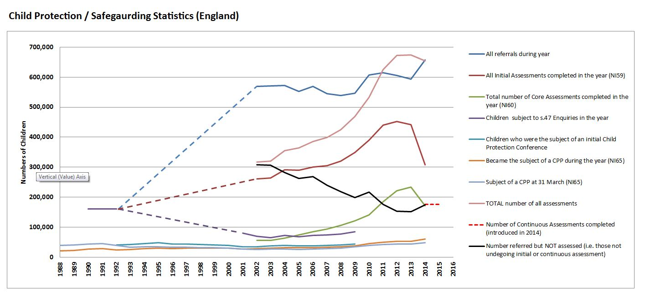
Trend Analysis
Trend analysis: ‘more in’ aim may not = less abuse.

Slide 6
Responding to adverse events
Failure Analysis - Investigating serious adverse events:
Public Inquiries, Serious Case Reviews, Child Death Review Process.
It was already established that there are no particular risk factors that characterise the most serious cases.
Leaves little to be learnt, findings are general but slanted towards more intrusive and coercive surveillance and data sharing. A by-product is individual/organisational ‘blame’ leaving the social work profession stigmatised.
Creates a culture of fear of ‘missing something’. Sanctions for under-interventions, no sanctions for over-intervention.
Costly, and provides no reliable research findings on which to base future policy.
I published an article on these issues in 2015 (Devine, 2015). The Wood Report (2016) broadly agree that SCRs and CDRP are ‘not fit for purpose’ and are to be redesigned. Not surprising & example of sudden shift in policy.
Our observation: There is a long and interesting history of government response to adverse incidents. The Child Death Review Process and SCRs are an interesting example of government protective action following potential or actual scandals. Very interesting that a move is to be made now to relocate them into central government control with administrative data implications.

Slide 7
Risk prediction
The third and final section of our current investigation.
Sometimes right. How often? What do we know?
Derived from a theoretical model adopting germ theory principles.
Risk is a probability calculation – speculative, difficult to prove and impossible for parents to disprove.
Makes it mandatory for parents wanting services to be ‘risk assessed’ in order to access them. This scrutiny can escalate them into a more coercive process because they have certain characteristics. For example…

Slide 8
Risk unreliability tables

Slide 9
Identifying the welfare/policing dichotomy
Article published in the Journal of Social Welfare & Family Law to introduce and consider social work assessment of families (Devine, 2015b).
Took as a fundamental principal that the rule of law is a moral and practical imperative in terms of state intervention and its balance with private life.
This starting point does not assume a discourse-led justification for interventions (eg welfare) but looks at the principles of law enabling statutory social work and its boundaries.
The conclusion was that the interpretation of the law and the mixing of ss.17 and 47 was not the original intention of the legislation. This has been progressively eroded by successive policies.
Detailed discussion of the issues were more complex than an article could deliver, and somewhat outside the scope of our project (which is an enquiry into, not a theoretical discussion about).
So I wrote a book…

Slide 10
The book: Exploring the concept of policing parents within a welfare model
State Powers
Assessment
Consent
Remedies
Private Rights
Surveillance
Mandatory reporting
Concerns/
Allegations

Slide 11
‘The Limits of State Power & Private Rights: Exploring Child Protection & Safeguarding Referrals and Assessments’
Overall conclusion… We are at a position where we have a confused system characterised by a welfare/policing dichotomy. This is a problem for families faced with the ‘working with’ agenda. ‘Working with’ = necessary compliance. Question: what would a legal and ethical system look like? Suggestion in the book for a new design is made to start a much needed debate (its not the last word!)

Slide 12
Parents & Social Workers: ‘working together’, or reluctant partners? Barriers to achieving a productive relationship: Investigation into the policing (criminal justice) and the social work (welfare) models
Investigating the ‘welfare/policing’ dichotomy.
What are parental barriers to ‘working with’ social workers?
Research findings primarily indicate fear, mistrust and trauma.
Policing model or a welfare model will work well with certain situations.
Worst of both worlds? A policing model embedded within a welfare framework.
This will work well for the ‘model service user’– but it works progressively less well for the outliers.

Slide 13
Outliers
Outliers fall on two outer edges of the spectrum:
(A) Those who have no difficulty meeting their children’s needs.
(B) Those who are systematically and deliberately abusing their children.
Both positions represent extremes.
Both are likely to fail to engage. But for different reasons.
Models of social work in such circumstances become methods to create an environment of compliance where ‘insight into problems’ and ‘showing capacity to change’ are key.
Failure to do those things can cause escalation into the litigation states of the Public Law Outline.

Slide 14
Next steps for the research agenda
Our research will map the characteristics of a policing and a welfare model and uptake of these models, and their outcomes on referrals & assessments.
This will inform the outline of a new ethical/legal welfare intervention framework.
Social work models that coerce compliance (unless there are clear grounds for dispensing with consent) fall into a category should be reviewed under a new ‘lawful/ethical’ framework.
International child justice project – Creating an international map of the ideological ethical/legal child protection system. Adherence to the rule of law. Creating a global measure & index.

Slide 15
National Network for Safeguarding Futures
As well as policy influencing research findings, an important outcome of the Rethinking Child Protection Strategy project was the aim to create an opportunity to engage all levels of stakeholders in:
Research;
Debate;
Public engagement and awareness events;
Action for change.
We will base the Network at the University of the West of England, Bristol, and will work with strategic partners on where things go from here.

Slide 16
Actions & Events
We have issued the first of four ESRC Ministerial Evidence Briefings.
Our findings will be published.
We will work with policy makers and stakeholders to increase the impact of our work.
Our Social Enterprise will be rolled out nationally.
Next year’s Transparency Project Conference will be held at UWE, Bristol on Friday, 9th June 2017.
Our symposia series will start, and will be called the ‘Mind the Gap’ Symposia Series. It will be complementary to the annual conference and provide additional fora for focussed debate on topics of interest.
The Network will work with existing and future ideas, initiatives & support groups, and will explore funding opportunities.

Slide 17
Project Information
Contact details (Principal Investigator & Co-Investigator):
Dr Lauren Devine. E: Lauren.Devine@uwe.ac.uk Twitter: @DrLaurenDevine
Stephen Parker. E: Stephen3.Parker@uwe.ac.uk Twitter: @Stephen3Parker
Project web pages:
Rethinking Child Protection Strategy, ESRC funded project (Grant Ref: ES/M000990/1)
W: http://www1.uwe.ac.uk/bl/research/childprotectionstrategy.aspx
E: transformative@uwe.ac.uk
Project & related publications:
http://people.uwe.ac.uk/Pages/person.aspx?accountname=campus\l-devine

